Slide 1
IT Governance – Part 1
Bob Marshall, MD MPH MISM FAAFP DoD Clinical Informatics Fellowship

Slide 2
Learning Goals
Introduce governance concepts and types of governance
Introduce Adaptive Governance and its principles
Discuss the four types of governance that lead to Adaptive Governance
Introduce the concept of “Fit for Purpose” governance
Discuss the five mechanisms underlying the four types of governance
Discuss causes of governance failures
Discuss MHS governance

Slide 3
Some Background
The days of a “one size fits all” approach to IT governance are numbered
Innovation, collaboration, acceleration, experimentation and distributed decision making may require new “best fit for purpose” governance approaches
Traditional governance, by itself, does not have the scope or the agility to address the new decision-making and operating models required by digital business (which includes government entities)
Organizations must be adaptive and nimble in their decision-making processes, responding quickly to opportunities while addressing risk and value

Slide 4
An Alternative Approach
Adaptive governance is the organizational capability that determines the governance style and mechanisms that will deliver required business outcomes in a given context
It offers four governance styles that are applied on a “fit for purpose” basis
The four styles start with foundational (i.e., traditional) control-based and outcome-based governance practices
Beyond these two basic governance styles, one needs to add agility-based and autonomous-based governance practices to meet the demands of digital business and functionality

Slide 5
Delivering Outcomes
Adaptive governance is a key step for public and private enterprises to take toward achieving sustainable outcomes
CIO’s and CMIO’s who collaborate and align with their business leader counterparts will be positioned to achieve digital business success by leveraging the four adaptive IT governance styles (see next slide) and associated capabilities to meet the diverse decision-making needs of an enterprise/organization

Slide 7
The Four Types of Governance in the Model
Control-based
Decision making according to rules, policies, standards, directives and compliance requirements from regulators dominates this command-and-control style of governance.
It remains a foundation of, and anchor for, governance of the enterprise
Outcome-based
This governance style aligns with achieving key business outcomes
Balancing risks and benefits, it has a broader purpose than governance focused solely on control and minimizing risk
Investment management and benefits realization are part of outcome-based governance

Slide 8
The Four Types of Governance in the Model
Agility-based
While respecting enterprise guardrails, agility-based governance empowers roles and teams with the authority to make decisions that create value for the business
In an opportunistic scenario such as digital innovation, where many of the opportunities may be unknown, decision making must be more fluid than usual and rely more on people’s competencies, principles, attitudes and ways of working, rather than on authority and rules

Slide 9
The Four Types of Governance in the Model
Autonomous-based
An autonomous-based governance style is required to drive value and manage risks when dealing with the exploding Internet of Things
The IoT is driving the need to leverage algorithmic machine-to-machine decisions, and to provide decision support in machine-human interactions
These decisions occur in real time and are executed by people or things. IoT cybersecurity and data governance are foundational to this style of governance

Slide 10
New Governance Practices
For many years, governance was applied to exert control
Mechanisms such as policies, directives, compliance, decision rights and authority drove decision making
In following the corporate governance-based principle of “comply or die,” this approach allowed for little deviation from one situation to another
Making governance more adaptable means adding new practices and approaches to the current governance repertoire
The next image depicts the enterprise IT maturity requirements for the new governance styles and associated capabilities

Slide 12
Governance Styles in Mature Organizations
As the figure suggests, a highly mature, adaptive enterprise would use the right combination of the four governance styles and associated capabilities in addressing a particular situation or scenario
Adding new governance capabilities in this way — that is, being more adaptive — gives the enterprise more options in applying “fit for purpose” governance
This is particularly important in a world that regularly introduces new digital business scenarios and challenges

Slide 13
Fit for Purpose Governance
In addition to diversifying its governance approaches, an enterprise needs to apply them on a “fit for purpose” basis
The control- and outcome-based governance styles and their mechanisms support IT decision making in a more traditional business setting — for example, in the delivery of core infrastructure, operations and back-office systems of record
In meeting the needs of IoT and full-on platform- and ecosystem-based digital business, autonomous-based governance, the most complex and mature of the four styles, requires decision-making models that rely on real-time, machine-to-machine algorithmic decision models, and on machine decision support of human interactions

Slide 14
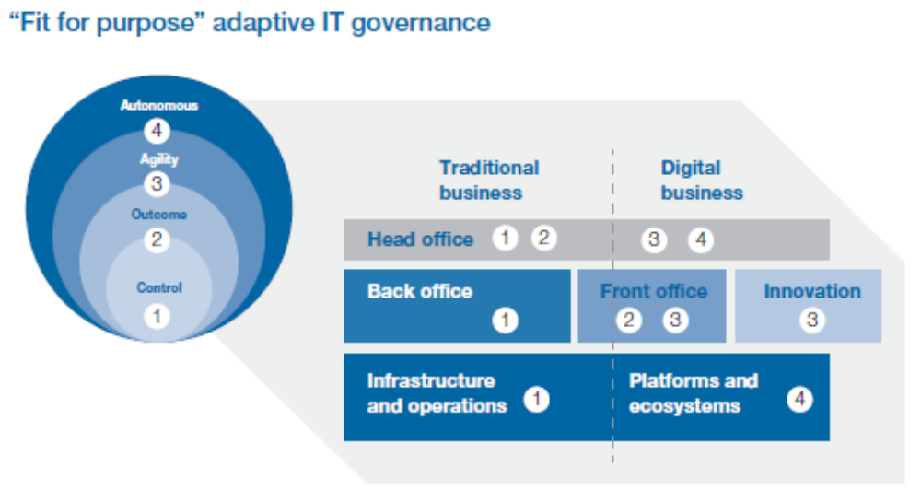

Slide 15
Implementing Adaptive IT Governance

Slide 16
Adaptive Governance Mechanisms
Governance mechanisms are the organizational arrangements — including people, processes and technologies — that enable and support decision making related to achieving business outcomes
They execute governance, promoting efficient use of IT while driving change, and their quality determines the performance of the governance capability
Five governance mechanisms underpin the four adaptive IT governance styles

Slide 17
Rule-based mechanisms
Based on IT policies, compliance, technical standards, architecture principles, mandates and other enforceable business rules
They are the most recognizable mechanisms because they hark back to the origins of governance
Examples of rule-based mechanisms include the enterprise mobile-device policy and any compliance activity

Slide 18
Structure-based mechanisms
Based on the interplay of the structures that drive decision making
Structures can be on a functional level (board, committee, etc.) or on an organizational level (e.g., auditing)
The investment council, architecture review board and board of directors are examples of structure-based mechanisms

Slide 19
Process-based mechanisms
Based on the processes that drive decision making
These processes assure that the right controls, checks and balances are addressed before a decision is made
Examples of process-based governance mechanisms are the business case process, architecture design review process, portfolio management process and risk management process

Slide 20
Role-based mechanisms
Based on the interplay of roles — on the functional or organizational level — that drive decision making
Role-based mechanisms include business relationship manager, senior supplier, senior user and product owner

Slide 21
Values-based mechanisms
Pervasive, applying to structure-, role- and process-based mechanisms
They consider values inside and outside the enterprise as drivers of decision making, addressing the ethical, moral, cultural, behavioral, sociological, political and economic aspects of society and technology (including AI and robotics)
Values-based mechanisms are essential influencers of technology decisions from societal and human perspectives
They are not “hard-coded” in the organization like directives or policies; they are instilled in the culture and expressed by behavior, ways of working, beliefs and ethics

Slide 22
Governance Failures

Slide 24
Top reasons for IT governance breakdowns
Breakdown | Description
Wrong focus areas | The wrong focus areas are addressed, leading to a governance function that is misaligned and therefore unable to address the right concerns to raise performance and deliver business outcomes
Designed by IT for IT | The governance function has been designed by IT without consulting the business. As such, it only addresses the IT organization and its performance, rather than the business it serves. In short, there is no enterprise focus
Management vs. governance | Because the governance board is responsible for addressing management topics, it focuses less on governance, which causes confusion on issues of ownership and delegation across the management vs. governance scope (e.g., spending vs. investments)
No evaluation of performance | A governance board cannot be effective without a means to evaluate its performance — the decisions it has made, the processes it has applied, the outcomes it has achieved and the areas in which it needs improvement
No business case process | Business cases drive decision making and provide clarity on resourcing and risk. A governance board makes decisions based on business cases that evaluate proposed investments against expected benefits.

Slide 25
Application to the MHS

Slide 26
MHS Governance
What is the current style of governance for:
IT infrastructure
MHS GENESIS
AHLTA/CHCS/Essentris
Data and Business Intelligence
Are the current governance models working well?
What alterations in current MHS governance processes would you suggest to make them more effective and efficient?

Slide 27
OCHIO Solution Owner Model and Governance
The model envisioned by the OCHIO is for a governance model using “Solution Owners” for each of the MHSG focus areas
Do you think this model is optimal for efficiency and efficacy with MHSG?
If so, what suggestions would you make to optimize it…if any?
If not, what changes would you make to improve it?

Slide 28
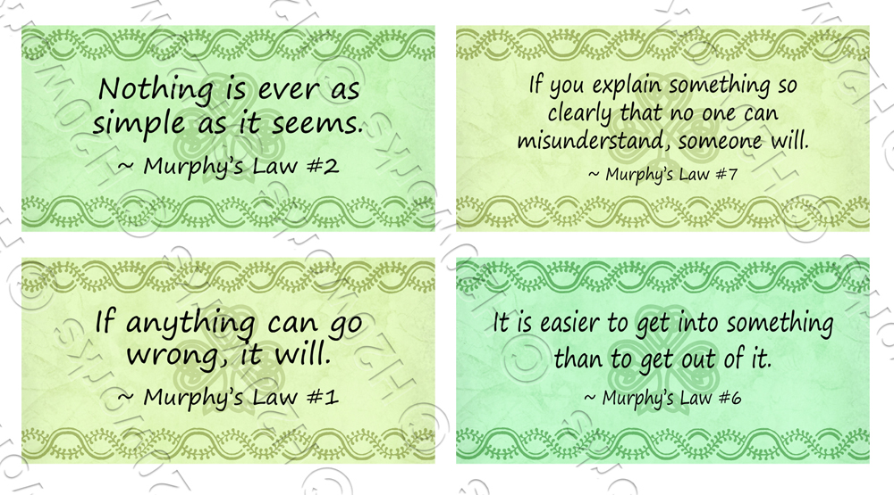
Questions and Comments

